Slide 1


Improving the safety of vulnerable road users
PIN Talk, Ljubljana | 19 September 2024
Jenny Carson
Project Manager

Slide 2
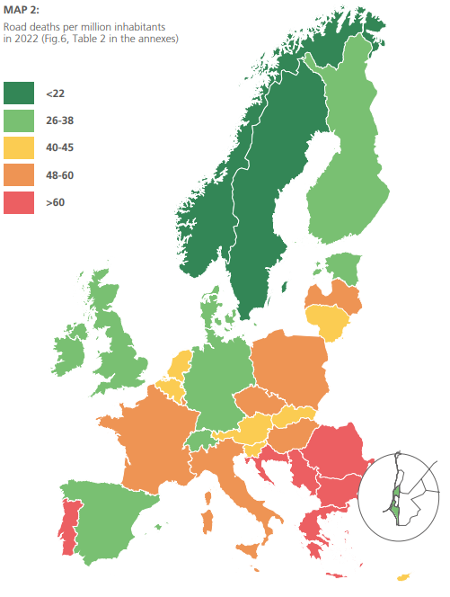






ETSC PIN PROGRAMME
Experts from the 32 participating countries, including all EU Member States
Steering Group
Annual report
PIN Flash reports (46 so far)
PIN Talks

Slide 3
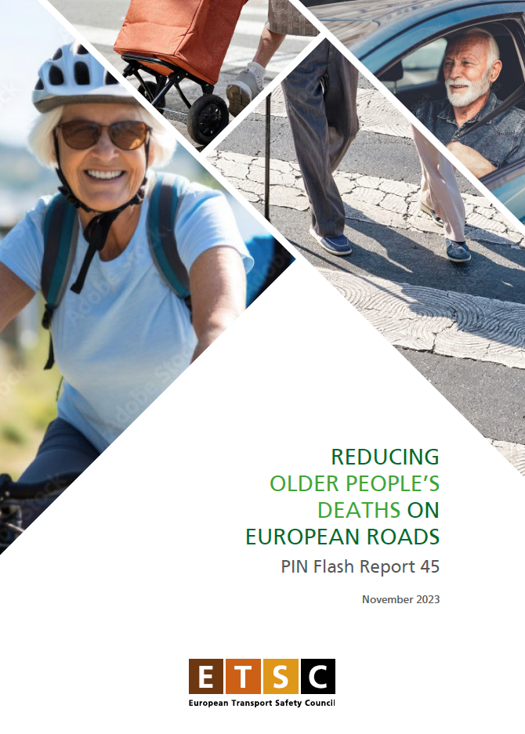
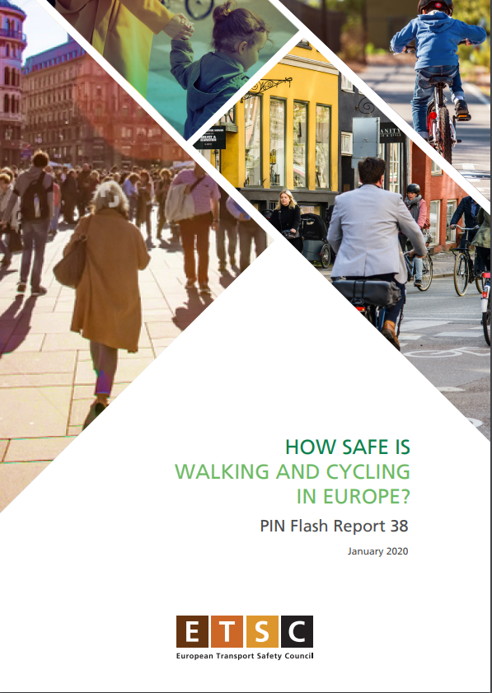
PIN Flash Report 45
Reducing older people’s road deaths on European roads
Published November 2023
PIN Flash Report 38
How Safe is Walking and Cycling in the EU?
Published January 2020
Notes:
Update of a previous report we published in 2016

Slide 4
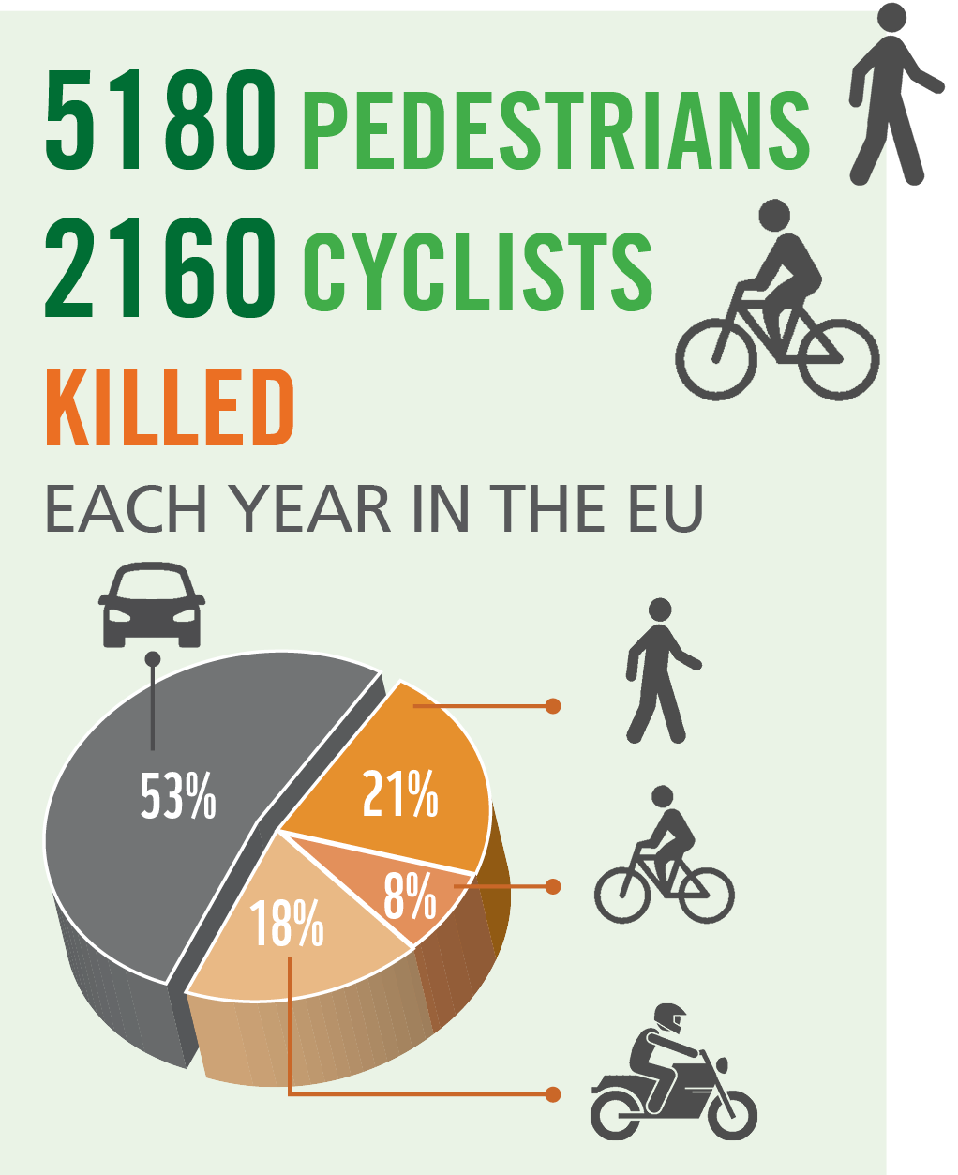
2018 figures

Slide 5
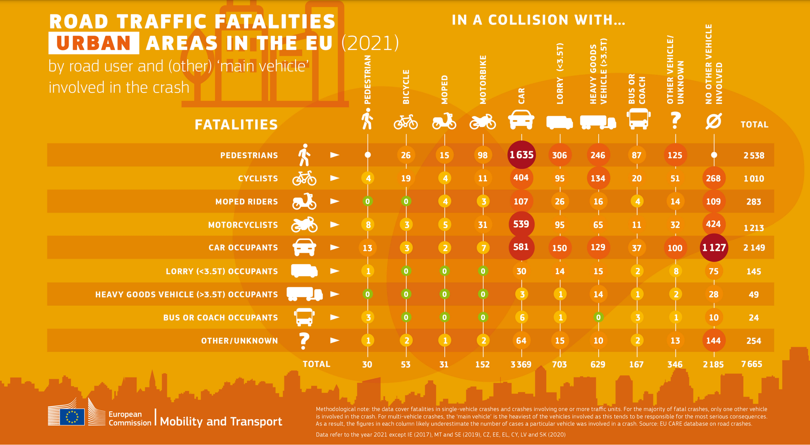
66% VRUs
1635
Pedestrians killed by car
Notes:
7665 people killed in urban areas in the EU in 2021.
Nearly 70% of these are vulnerable road users – pedestrians, cyclists and motorcyclists (actual % is 66)
In urban areas pedestrians tend to be killed in a collision with a car
Car occupants tend to be killed in a collision with no other vehicle involved.

Slide 6
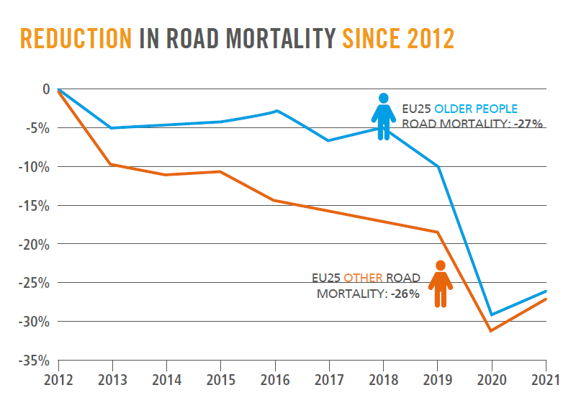
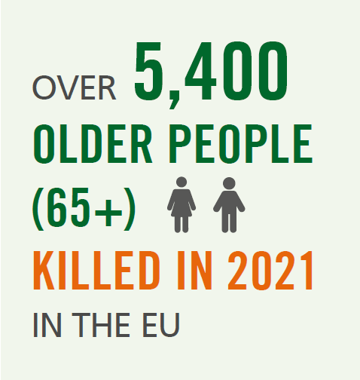
The scale of the problem – older people

Slide 7
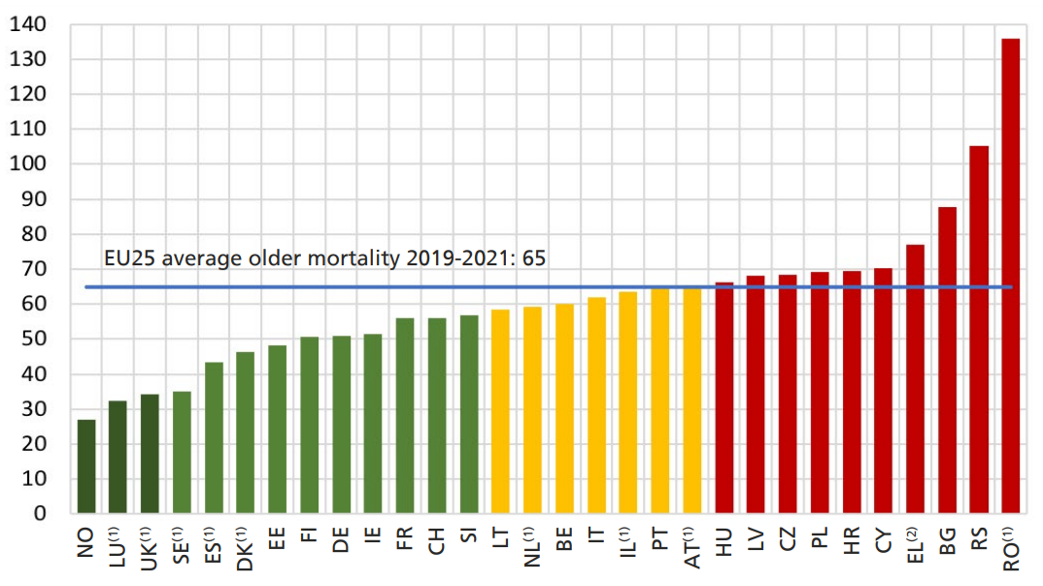
Road mortality older people – country comparisons

Slide 8
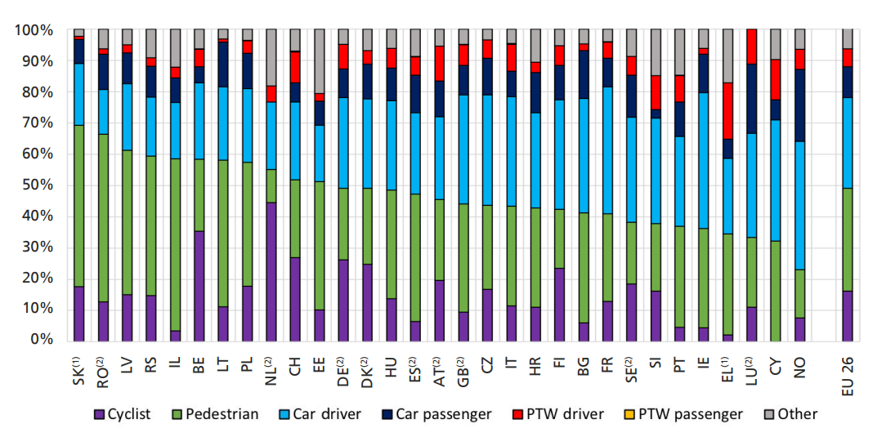
Older people - road user groups
Average 2020-2022

Slide 9

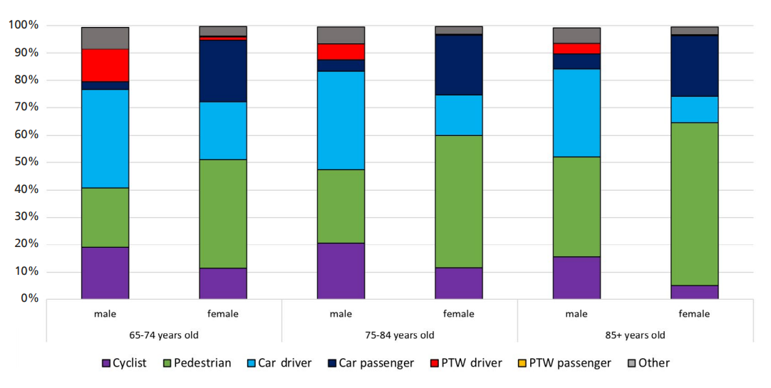
Gender
Average 2019-2021

Slide 10
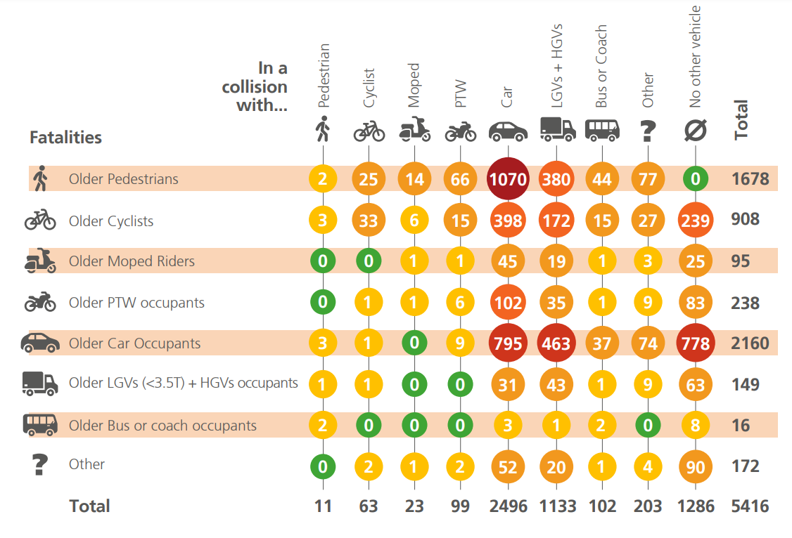
EU CARE Database 2021

Slide 11
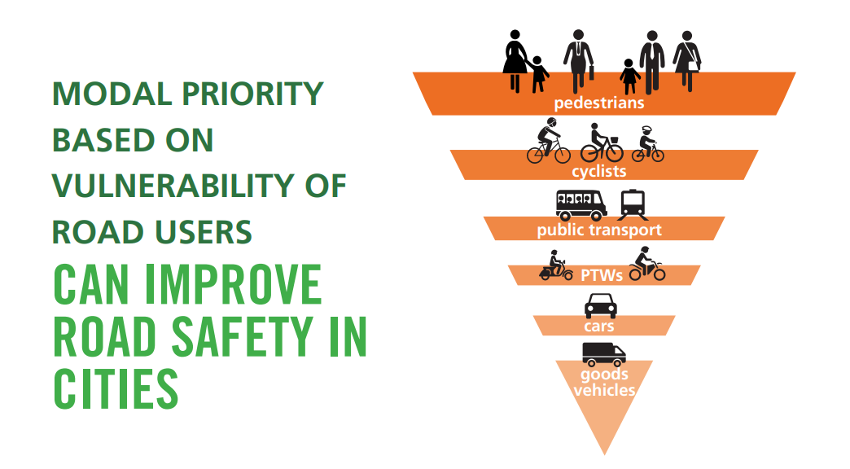
Modal priority
Notes:
Adopt and promote a policy of modal priority for road users, the hierarchy being based on safety, vulnerability and sustainability. Walking should be at the top of the hierarchy, followed by cycling and use of public transport.

Slide 12
Countermeasures
Cycling and e-bikes
Pedestrian safety and pedestrian falls
Public transport – both outside and in the vehicles
Infrastructure – including speed management
Vehicle technologies – improving safety but also adapted to needs of older driver.

Slide 13
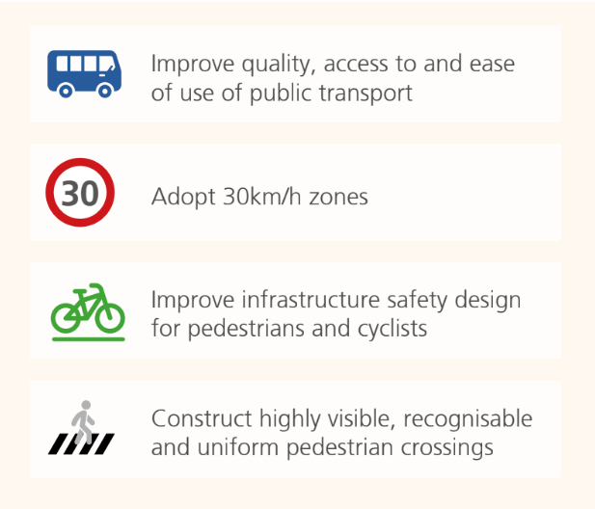
Recommendations

Slide 14
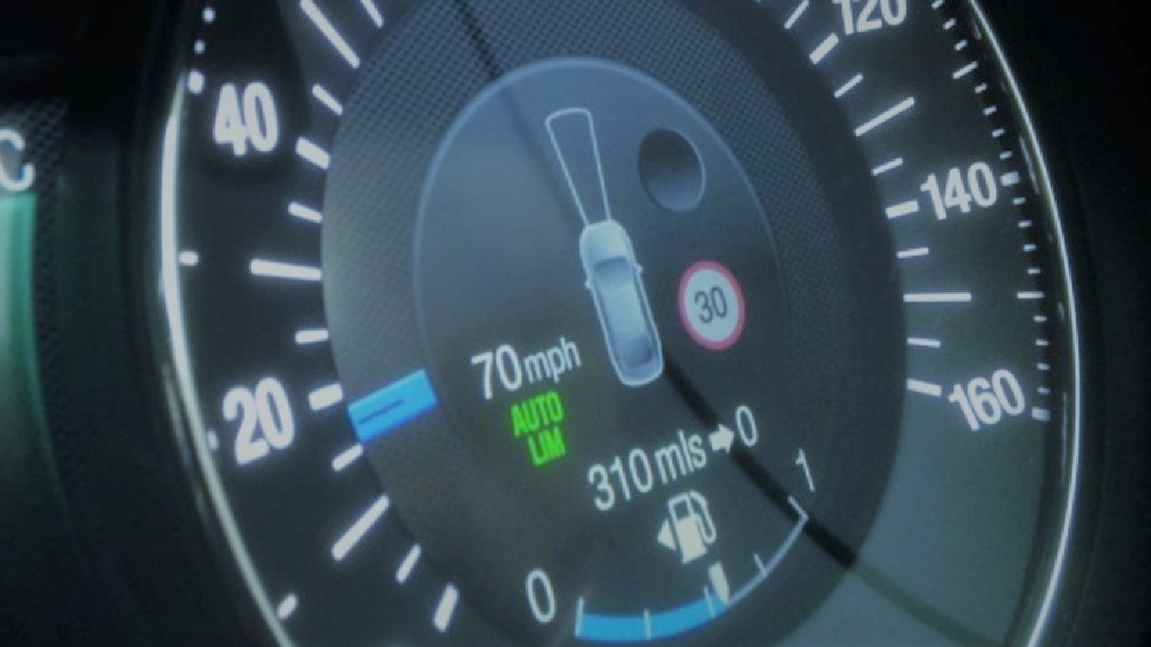

THANK YOU!
www.etsc.eu/pin
@etsc_eu
Jenny Carson
jenny.carson@etsc.eu
Notes:
Please feel free to download the report from the link here.

